Slide 1
Simple Linear Regression

Slide 2
Simple linear regression determines the relationship between dependent and independent variables. It is a statistical analysis which predicts values of dependent variables based on the values of the independent variables.
Consider equation of a straight line,
y = c + mx
where y is the dependent variable
c is a constant,
x is independent variable
m is an coefficient i.e. slope of the line.

Slide 3
implement simple linear regression we are going to create a new dataset containing at least 30 records of year of experience and total salary as follows.
See Salary_Data.csv

Slide 4
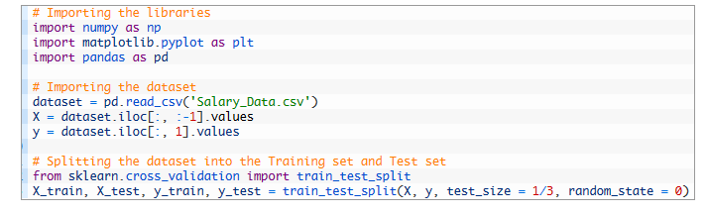

Slide 5
x_train : training data of independent variables. i.e. years of experience
x_test : test data for which we want to predict salaries
y_train : training data o dependent variables i.e. salaries based on years of experience
y_test : actual salaries for years of experience in x_test

Slide 6
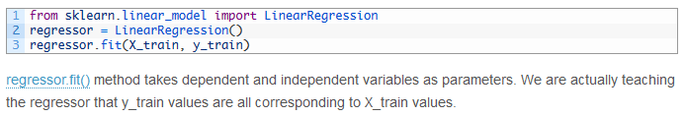
We are to fit our training dataset into simple linear regression model.To do this create an object regressor of class LinearRegression. Fit training data i.e. x_train and y_train in regressor as below.

Slide 7

Predicting salaries
We are now going to predict the salaries related to X_test values i.e years of experience and compare them with actual i.e values of y_test as below.

Slide 8
regressor.predict() method predicts the values of salaries depending on the years of experience in X_test.
y_pred values are predicted salaries and we will compare them with actual salaries which we have in y_test.

Slide 9
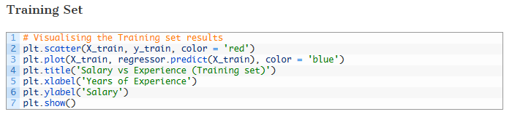

Slide 10
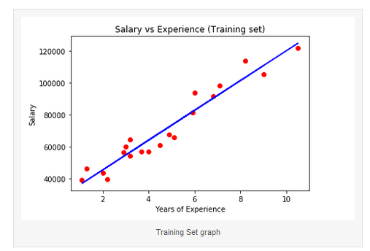

Slide 11
plt.scatter(X_train, y_train , color = 'red') plots scatter graph of salaries against years of experience for values in X_train and y_train
plt.plot(X_train, regressor.predict(X_train), color = 'blue') plots the graph of predicted salaries against years of experience.
Red dots represents co-relation between X_train and y_train i.e salaries and years of experience
Blue line is the simple linear regression.

Slide 12
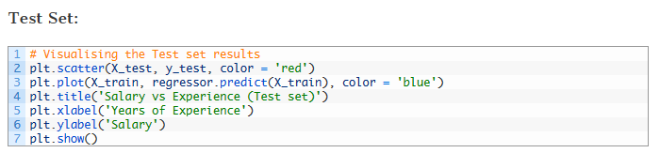

Slide 13
